Slide 1
A Case Case Study
Machine Learning Analysis of Maryland Judiciary Records
Spencer Miller, Deepayan Patra, Ashwin Srinivasan, Pranshu Suri, Emily Yu
Notes:
Spencer

Slide 2
“A court record that is kept in electronic form is open to inspection to the same extent that the record would be open to inspection in paper form.”
Maryland Access to Records Rule 16-1008 (2004)
Notes:
Spencer

Slide 3
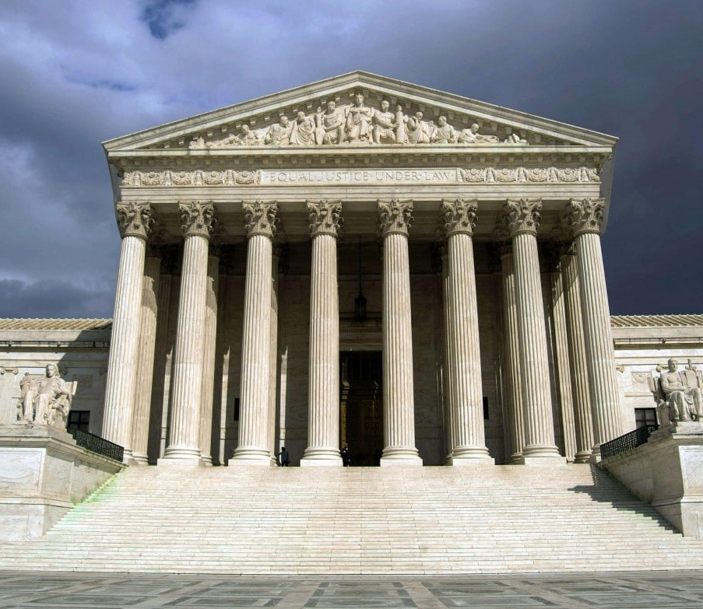
Goal
Extrapolate new, meaningful knowledge from judicial records
Support data-driven decision-making for public policy
Notes:
Spencer

Slide 4
Problem
Court records are obfuscated by archaic websites
Impossible to analyze trends
Notes:
Spencer

Slide 5
Solution
Extract intelligible information
Machine learning analysis
Notes:
Emily

Slide 6
Judiciary website
Web crawler
Parser
Analysis
Database
Notes:
Emily

Slide 7
Database
1
Modeled schema based on case attributes
PostgreSQL relational database
Notes:
Pranshu

Slide 8
------------------COURT RECORD------------------
The State of Maryland v. William Thomas Cummings
Plaintiff: State of Maryland
Officer: Rafter
Possession of undersized oysters: Not Guilty
Filed on: 12/22/2007
Verdict: 01/24/2008
Notes:
Pranshu

Slide 9
Schema
cases
judgements
events
parties
complaints
documents
charges
attorneys
Notes:
Pranshu

Slide 10
Web Crawling
2
Programmatically navigate webpages
Save case detail pages in database
Notes:
Dijon
· Website stores millions of cases, and somehow, they must all be read to determine trends
o Choose not to sit down with paper and pencil and record each case and information associated with it
· Use web crawler to collect every individual case mechanically
Extract data based on source code & perform requests on website

Slide 11
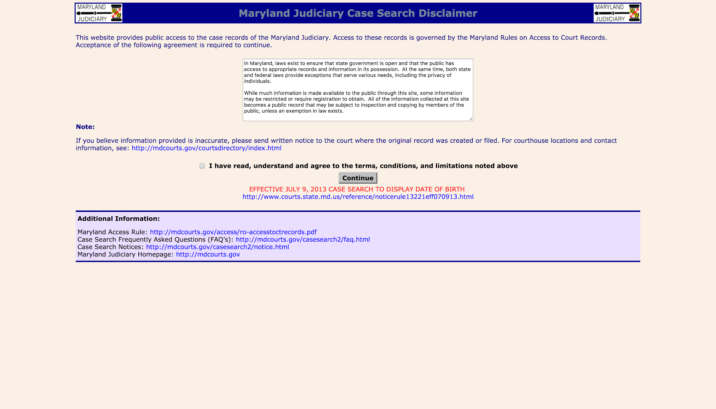
Notes:
Dijon
· Structure of first page: legal agreement, checkbox, and continue button… can easily see archaic structure
o Agreement introduces case search service and criteria
§ Important things is: released to public to read and copy
· Use scrapy framework to click checkbox and hit continue
o Scrapy is python framework built for scraping websites and performs a variety of functions, from webpage
o Will result in creation of cookie needed to access case search page
§ Cookie resets after every hour of inactivity → manually prevent cookie from timing out by resending with each request

Slide 12
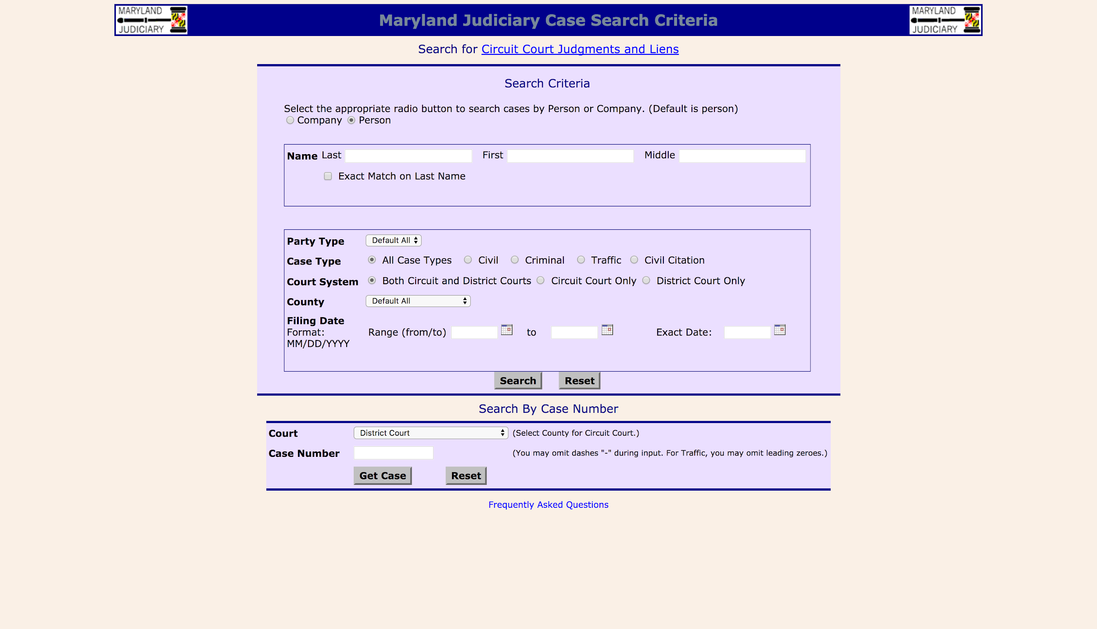
Cummings
William
Thomas
Notes:
Dijon
· Goal is to find every individual case
o Possible solutions: every last name, every case number
o Can’t know every last name in MD, casenumber is variable alphanumeric → can’t find every possible one… must use other parameters to collect each case
· Collect every case by using parameters on search page
o Iterate over last name by letter with selection as a through z
o Iterate over case type
o Iterate over court system
o Iterate over every individual filing date
o Results in 416 permutations for each date
· Run search for each
· Running example: call on someone in crowd (Chae) who will respond with William Thomas Cummings

Slide 13
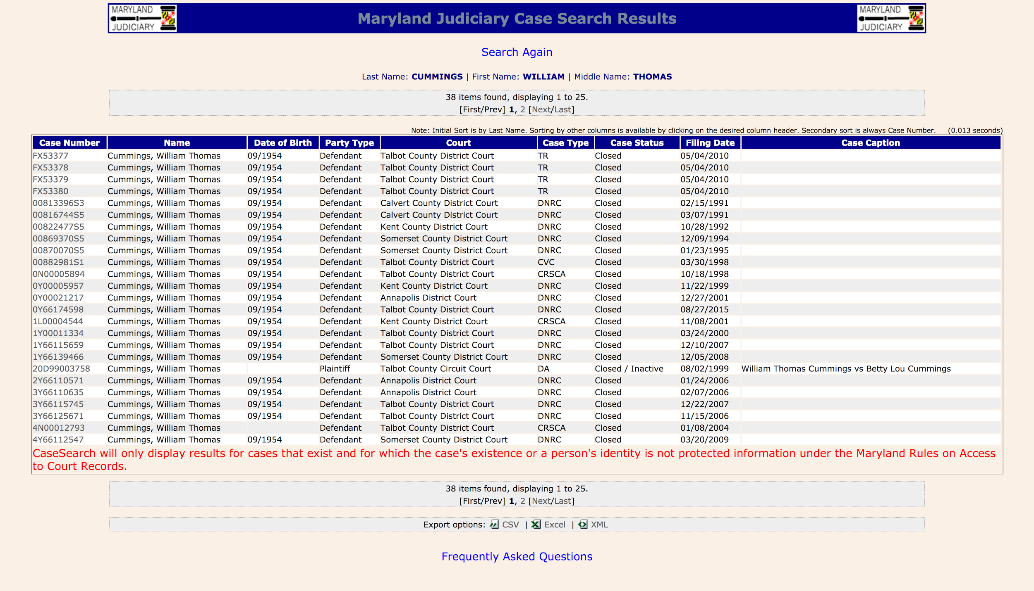
PGSS 2017 | ‹#›
Notes:
Dijon
· Results come in sets with maximum of 500, with 20, 25-item pages
· From this page, we extract the URL from the hyperlink on the case number

Slide 14
Maryland Case Search
Search page
Results page
Case detail page
Database
Disclaimer page
Notes:
Dijon
· HTML is downloaded from detail page and extracts case #
· Insert collected info into rawcases table in database

Slide 15
Parsing
3
Extract data from HTML source code
Insert formatted values into database
Notes:
Ashwin

Slide 16
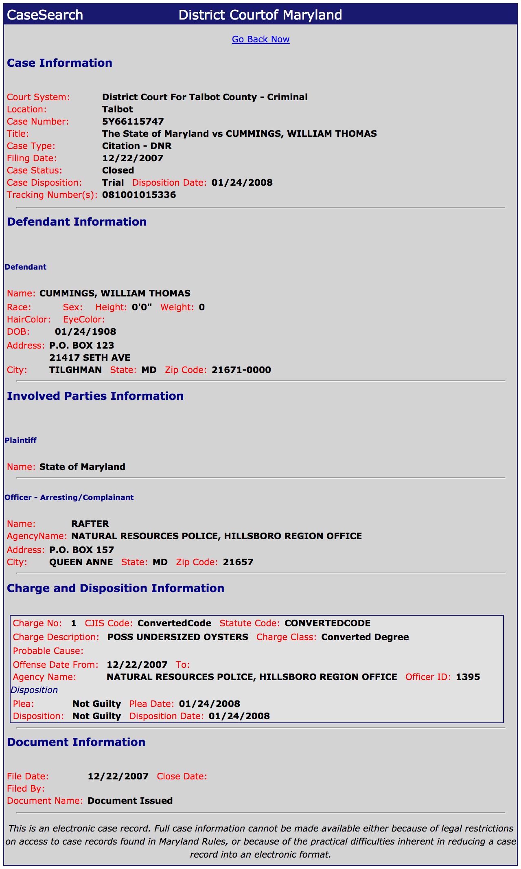
Notes:
Ashwin

Slide 17
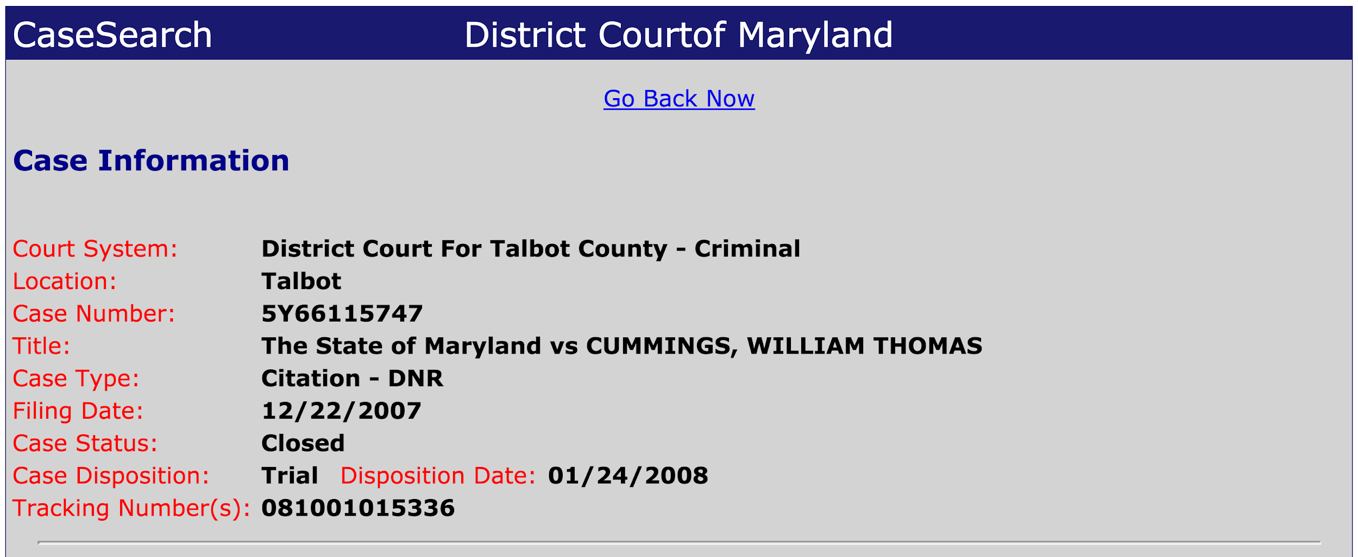
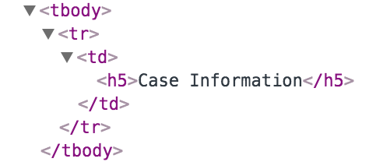
cases
Notes:
Ashwin

Slide 18
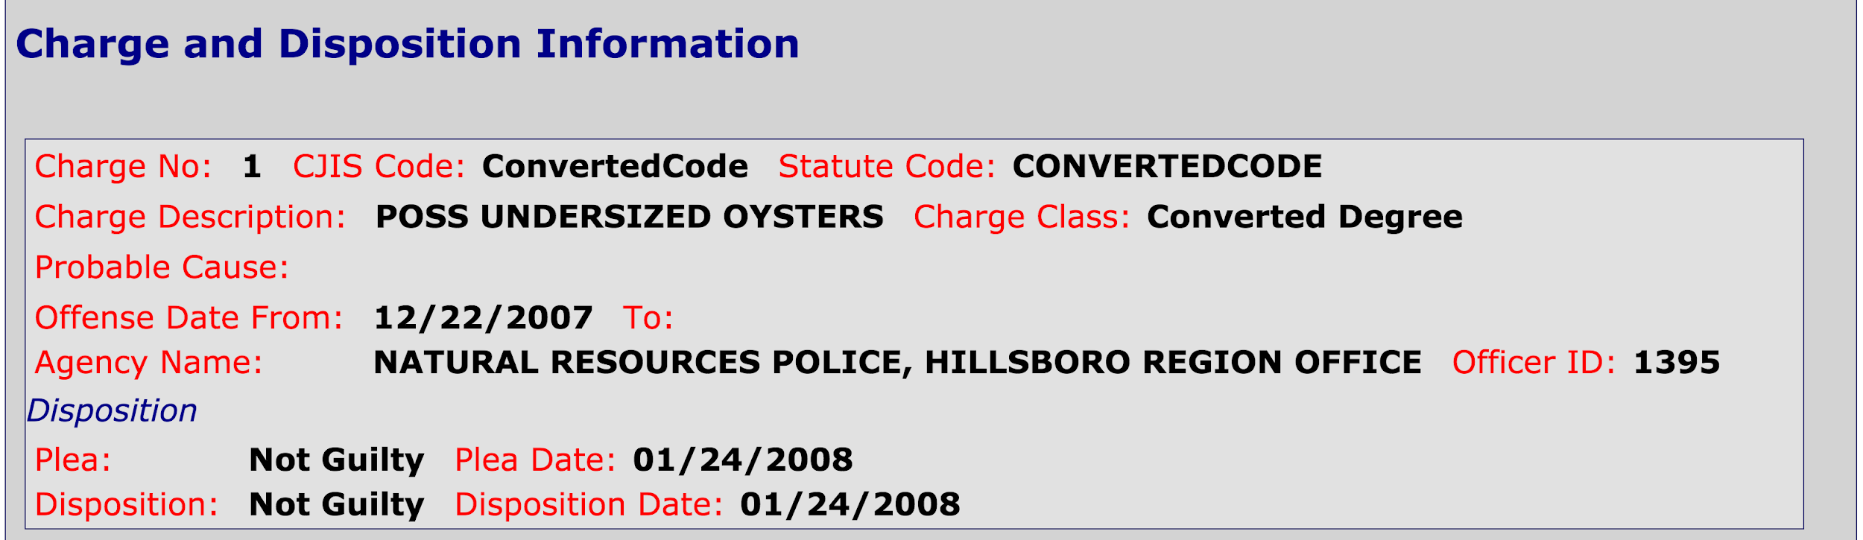
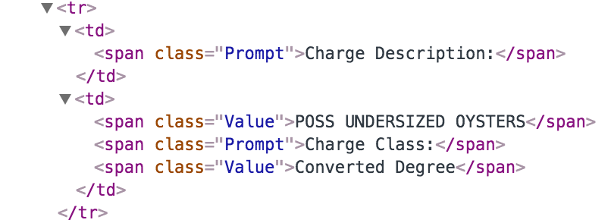
charges: [{description: ‘POSS UNDERSIZED OYSTERS, ...}]
Notes:
Ashwin

Slide 19
The Maryland court website is inconsistent and error-prone.
Notes:
Ashwin

Slide 20
12,513,450
10 years
cases collected over
7/1/2007 - 6/30/2017
Notes:
Ashwin
DEMO

Slide 21
Results and
Analysis
4
Notes:
Ashwin

Slide 22
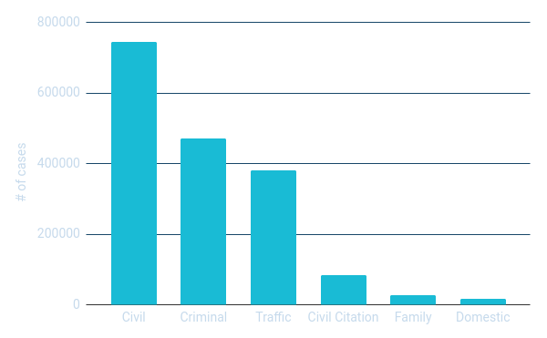
Case Type Distribution
Notes:
Ashwin

Slide 23
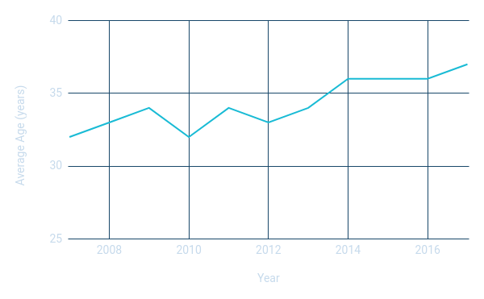
Age of Criminals Over Time
Notes:
Spencer

Slide 24
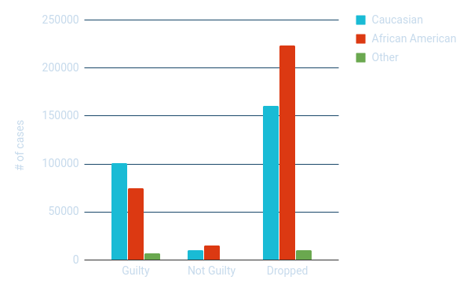
Disposition By Race
Notes:
Pranshu

Slide 25
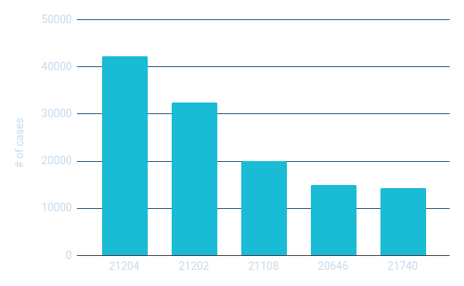
ZIP Codes with Most Crime
Notes:
Pranshu

Slide 26
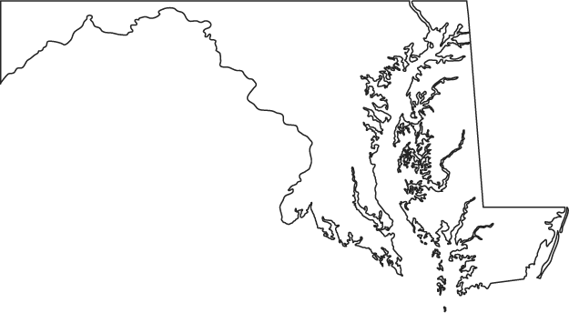
21740
21204
Baltimore
21202
21108
Washington,
D.C.
20646
Notes:
Pranshu

Slide 27
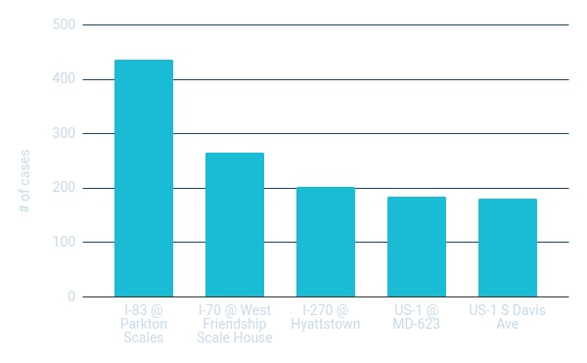
Traffic Ticket Locations
Notes:
Pranshu

Slide 28
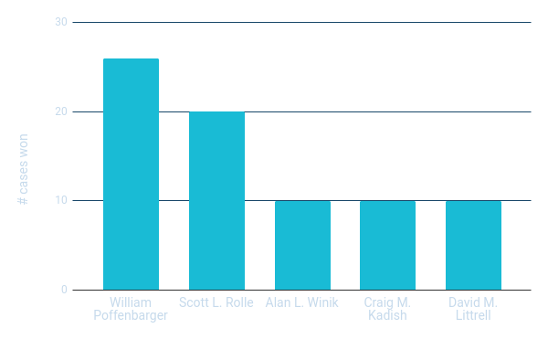
Most Successful Attorneys
Notes:
Emily

Slide 29
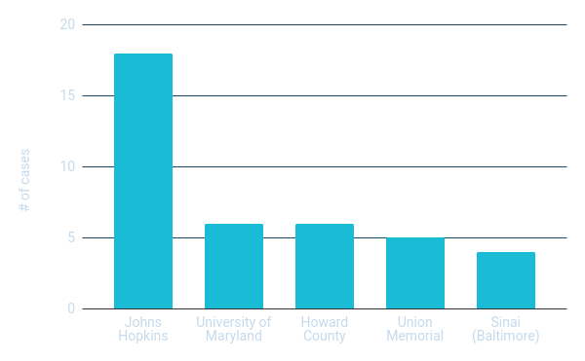
Medical Malpractice
Notes:
Spencer

Slide 30
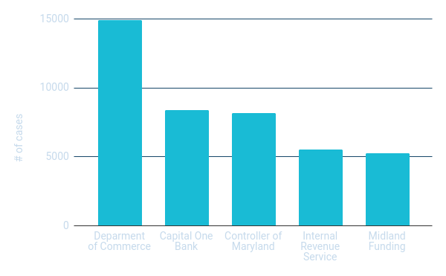
Civil Lawsuits as Plaintiff
Notes:
Emily

Slide 31
Superlatives
Worst Criminal
Nese Entullah Icgoren
Age 61
151 convictions
Worst Driver
Darrell Eugene Wilson
Age 32
36 offenses
Most Popular Lawyer
Stephen G. Peroutka
25,519 cases
Mainly civil cases
Worst Birthday
August 1st
Worst year: 1979
Most Common Offense
Second-degree assault
Possession of drugs
Worst Neighboring State
Pennsylvania
7,565 offenders
Notes:
Spencer, Pranshu
DEMO

Slide 32
Machine Learning
SUPERVISED
Decision tree classification algorithm
Predicts charge disposition
Inputs are defendant and case information
UNSUPERVISED
K-means clustering algorithm
Groups cases by common features
Continuous variables as inputs
Notes:
Emily

Slide 33
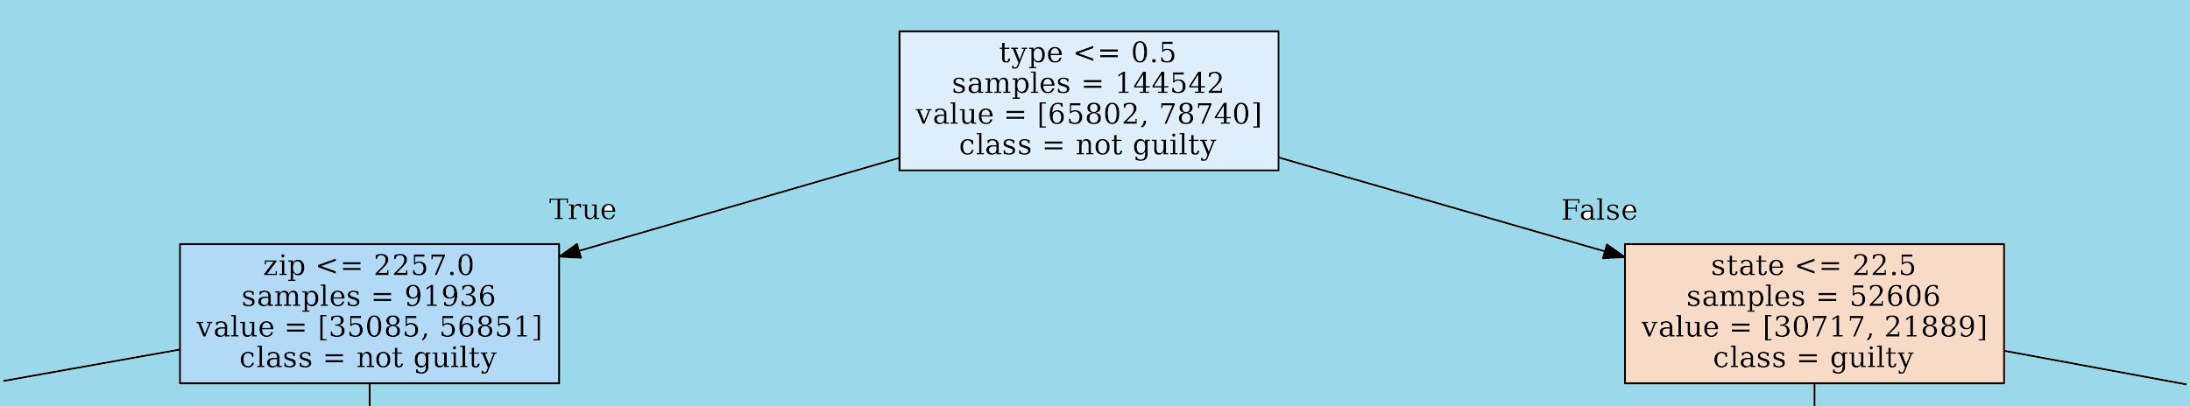
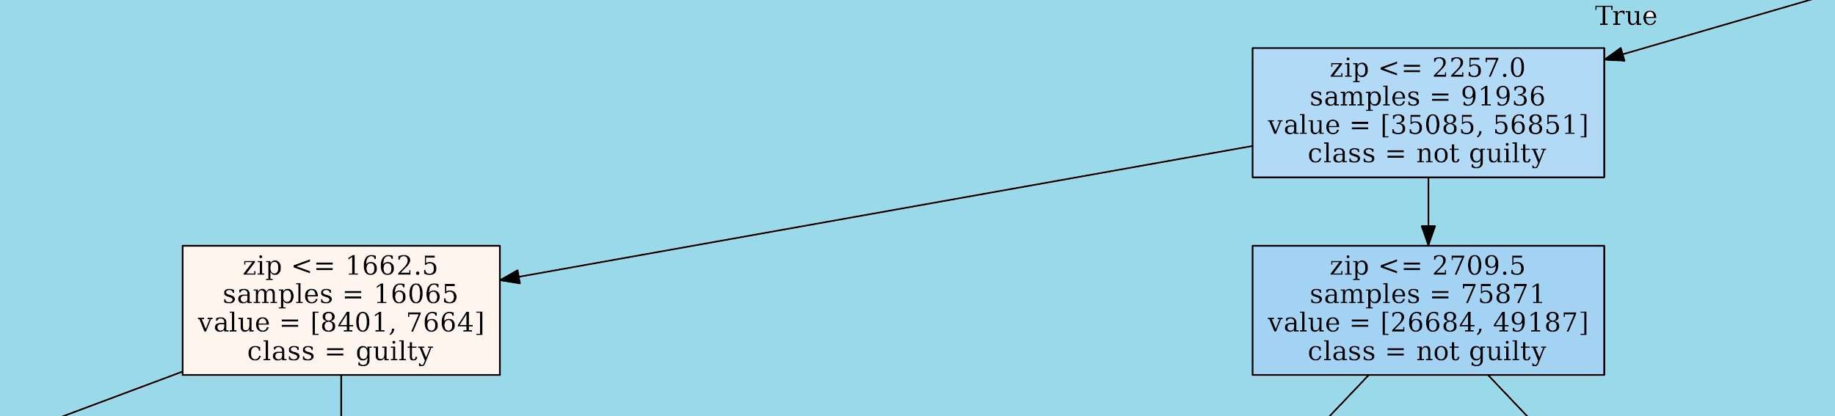
Decision Trees
Training Accuracy: 62.4%
Test Accuracy: 62.5%
Notes:
Dijon
· Selection of features that best classify data based on one characteristic… in our case, the disposition of the charge
o Chooses all samples and then divides based on parameter decided by algorithm
o Results in choosing the most efficient parameters
· Parameters are indexed, not valued since data was not numerical
· To choose parameters, function from scikit-learn’s machine learning library is run on segment of data to optimize solution
o After that, function is run on other data to test accuracy of algorithm

Slide 34
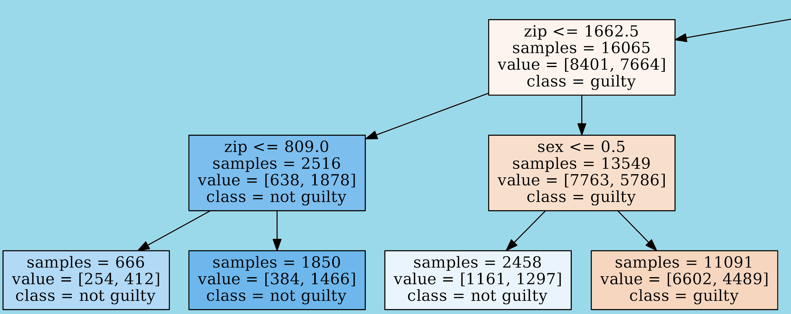
Training Accuracy: 62.4%
Test Accuracy: 62.5%

Slide 35
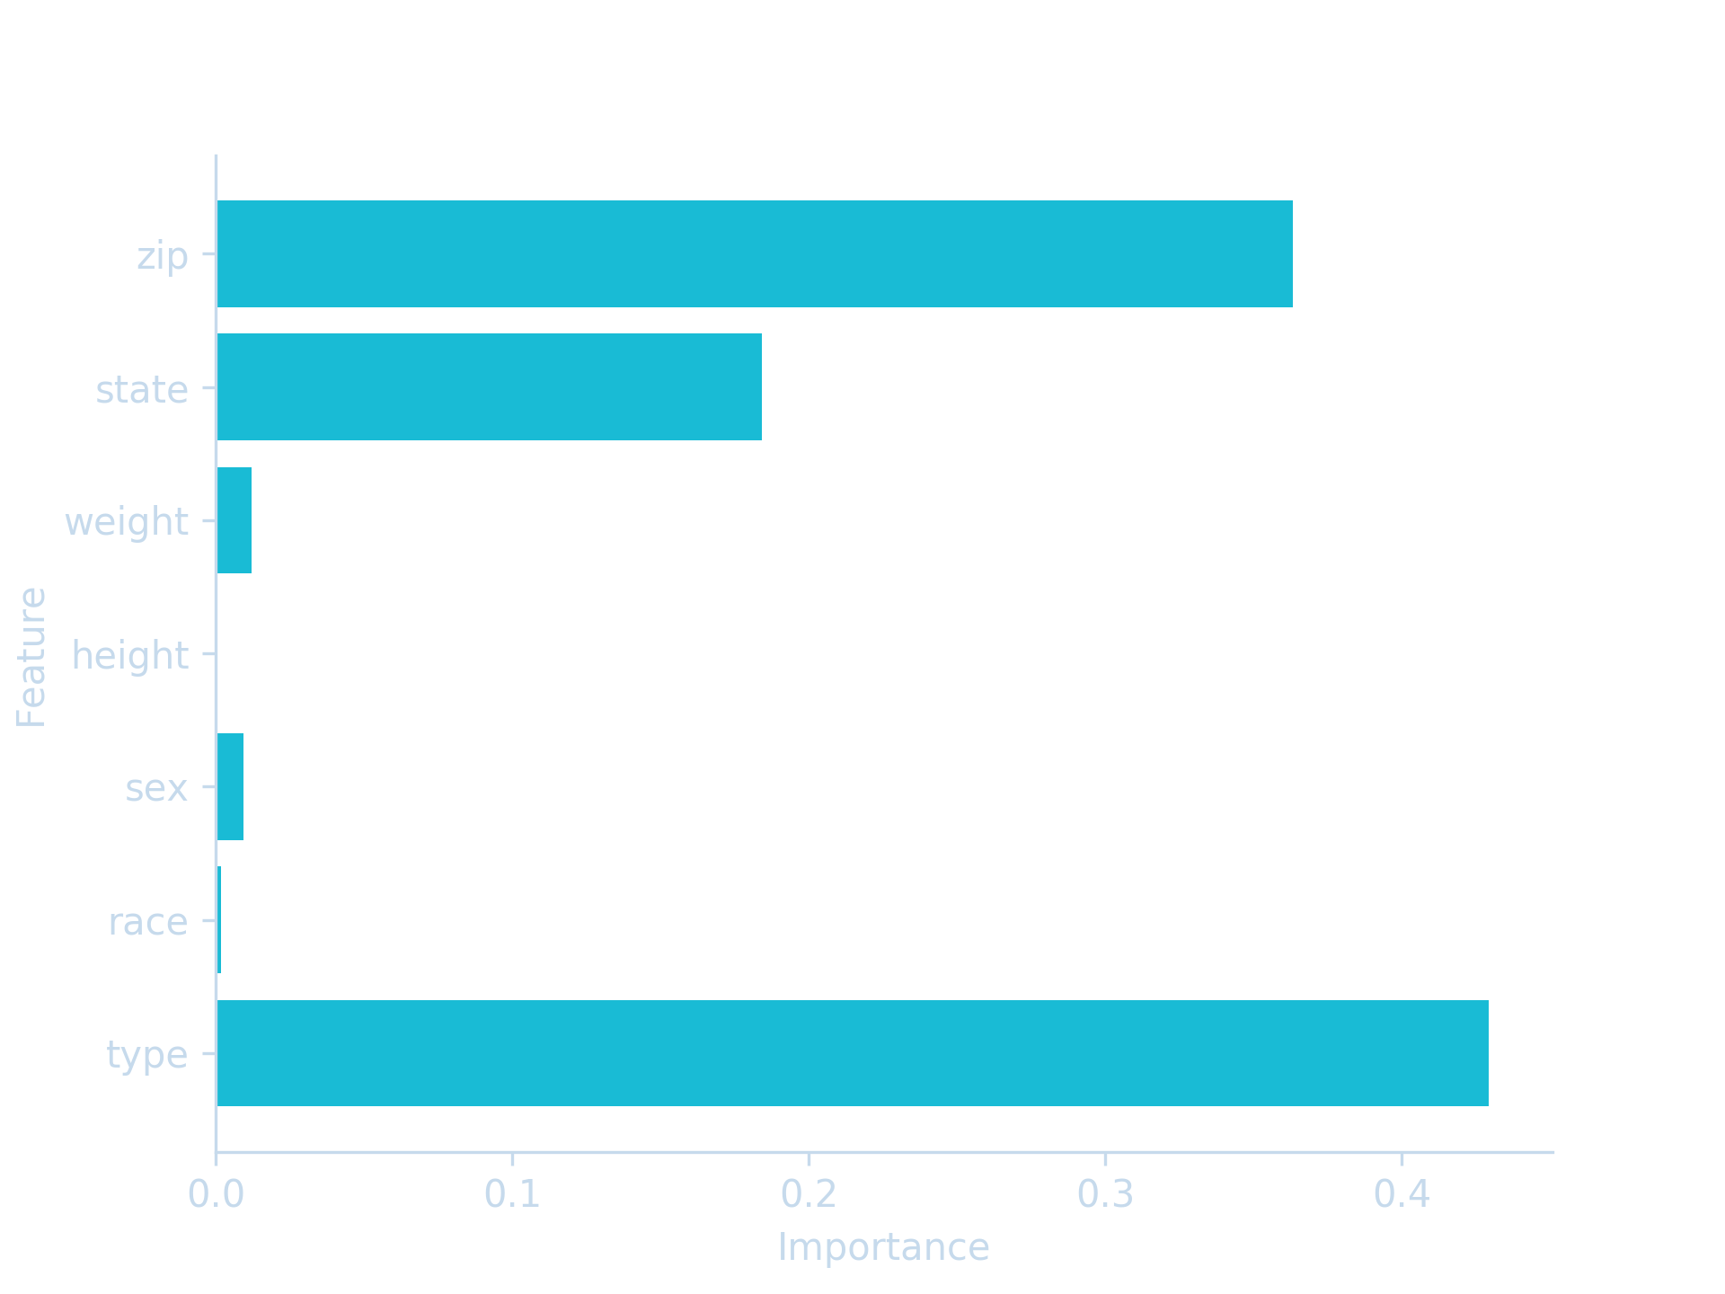
Overall Feature Importance
Notes:
Dijon
· Then use matplotlib, a python library for graph creation, to chart importance of features based on algorithm

Slide 36
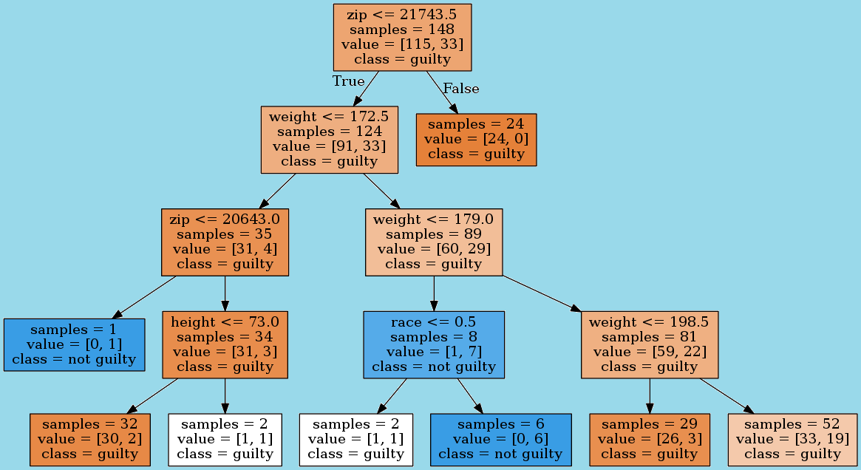
Training Accuracy: 80.2%
Test Accuracy: 81.4%
Notes:
· Continuing with oyster crimes, let’s see the decision tree for cases with oysters…
o So… apparently people who live in certain zipcodes and weigh less than 172.5 pounds are much more likely to be guilty than the average person, but everyone living outside the zipcodes in that parameter is definitely guilty
o Much greater accuracy for subset

Slide 37
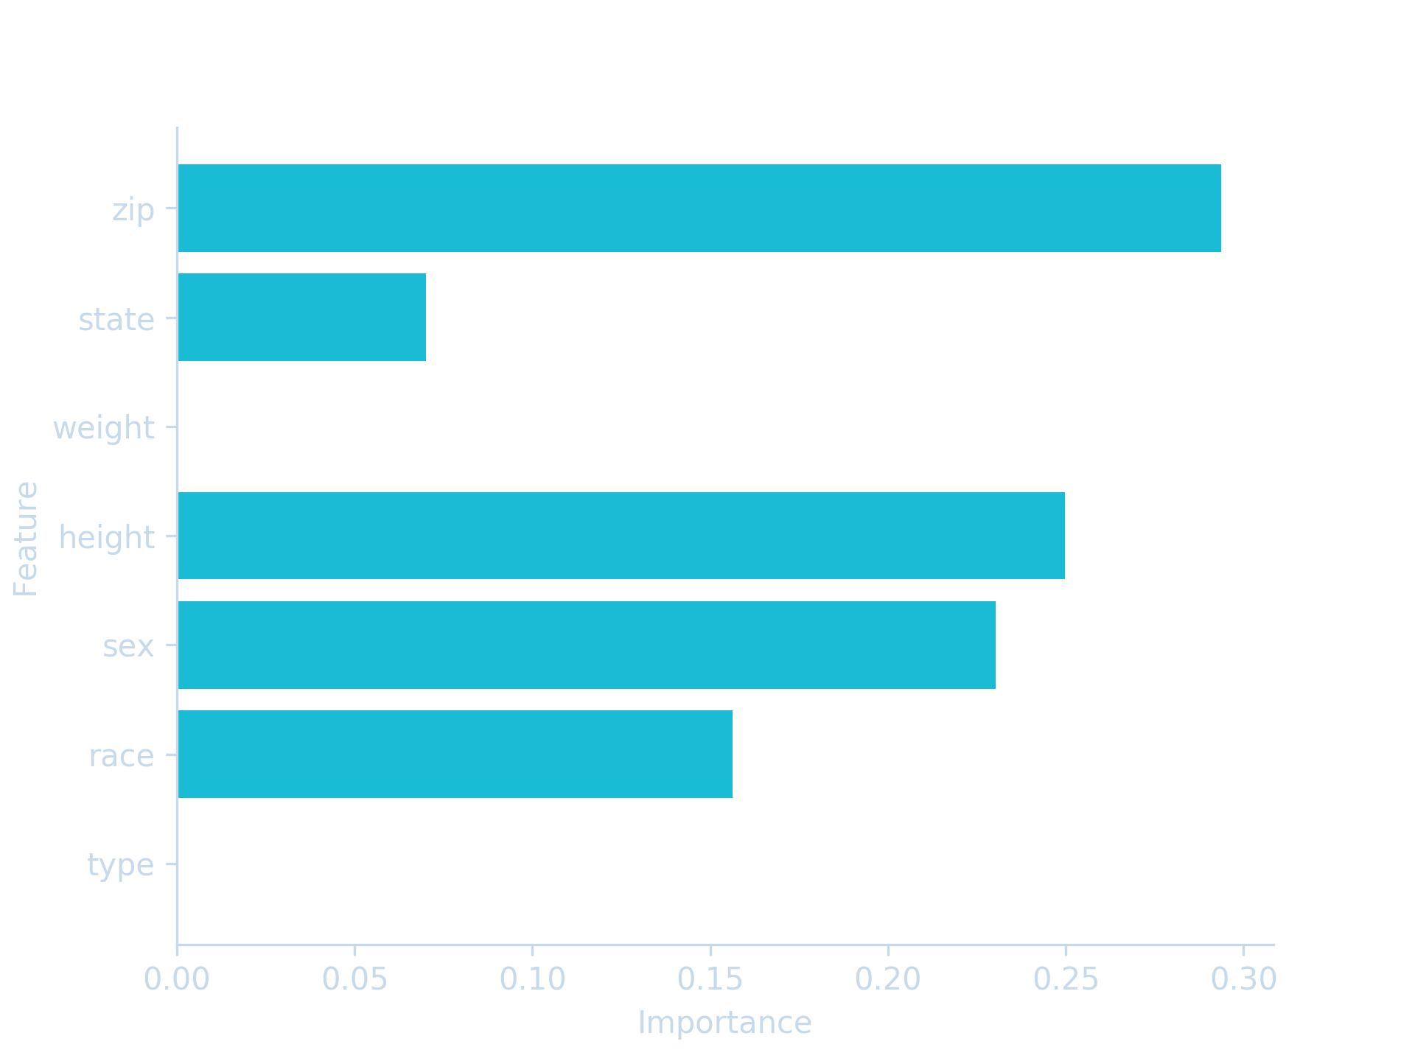
Oysters Feature Importance
Notes:
Dijon
o Features have relatively equal importance and all factor into results
o Zip comes to importance for those near ocean… increases probability that oyster case will occur
· So… if decision could be made on disposition before going to trial based on characteristics, people and companies could save money on lawyers and attorneys

Slide 38
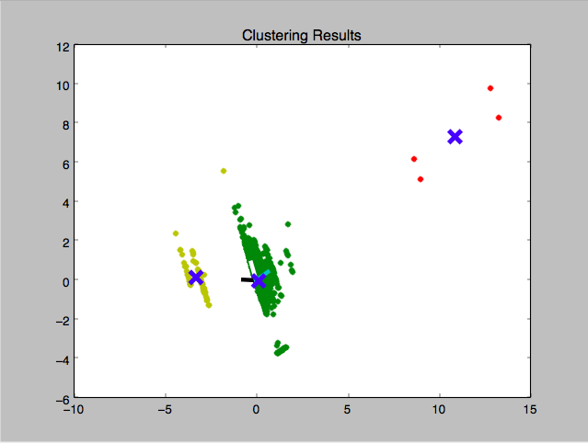
K-Means Clustering and PCA
Notes:
Emily

Slide 39
Future Work
5
Crawl more cases over longer time period
Public website and API to consume data
Applications of overarching principles
Notes:
Spencer

Slide 40







Acknowledgements
Andy Pavlo
Corey Emery
Notes:
Emily, Pranshu

Slide 41
Thank you.
Questions?
Notes:
Emily, Pranshu

